Slide 1

ECE 407 Soccer Winning Team Prediction
Stefan mijalkov

Slide 2
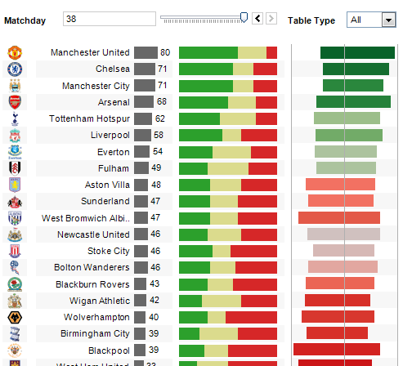
Project description
The idea of the project is to predict the winning team based on past match statistics and avoiding betting coefficients.
Type of machine learning: Supervised learning
Models used: Logistic Regression and Support Vector Machines

Slide 3
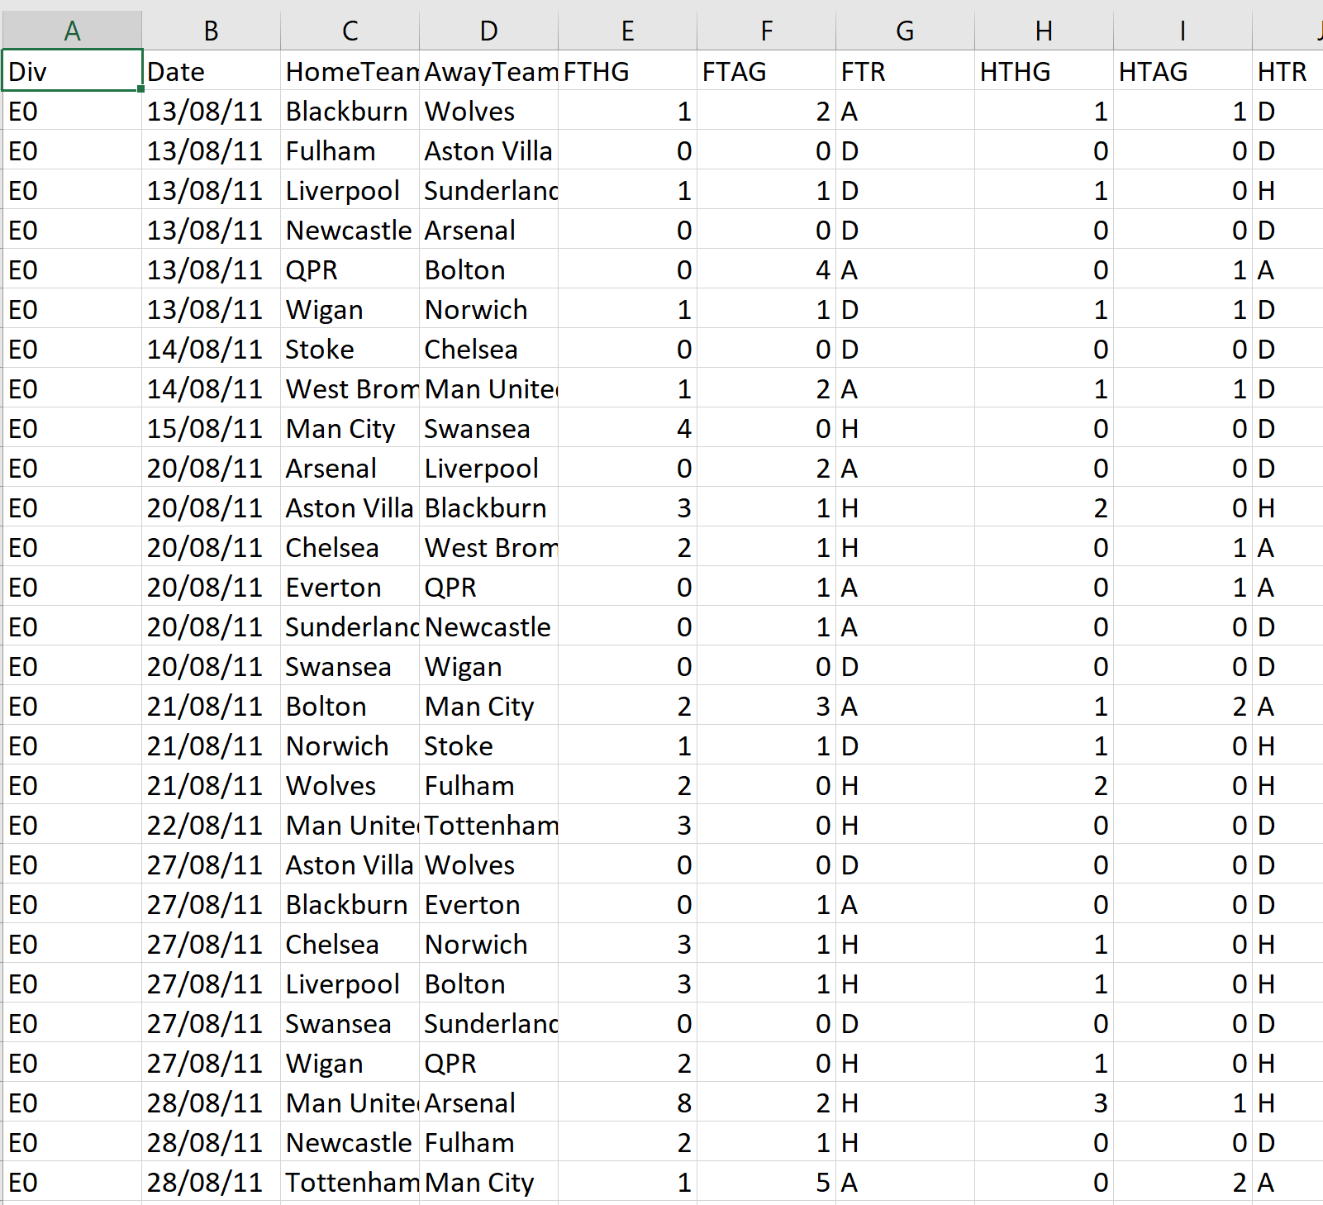
Dataset description
Database: https://datahub.io/collections/football
Contains statistics for 3 different soccer leagues: English Premier League, Spanish La Liga, and German Bundesliga
Format: 10 CSV files per league for the past 10 seasons
Features: Date, referee, shots on target, yellow/red cards, corners, fouls, half time score…

Slide 4
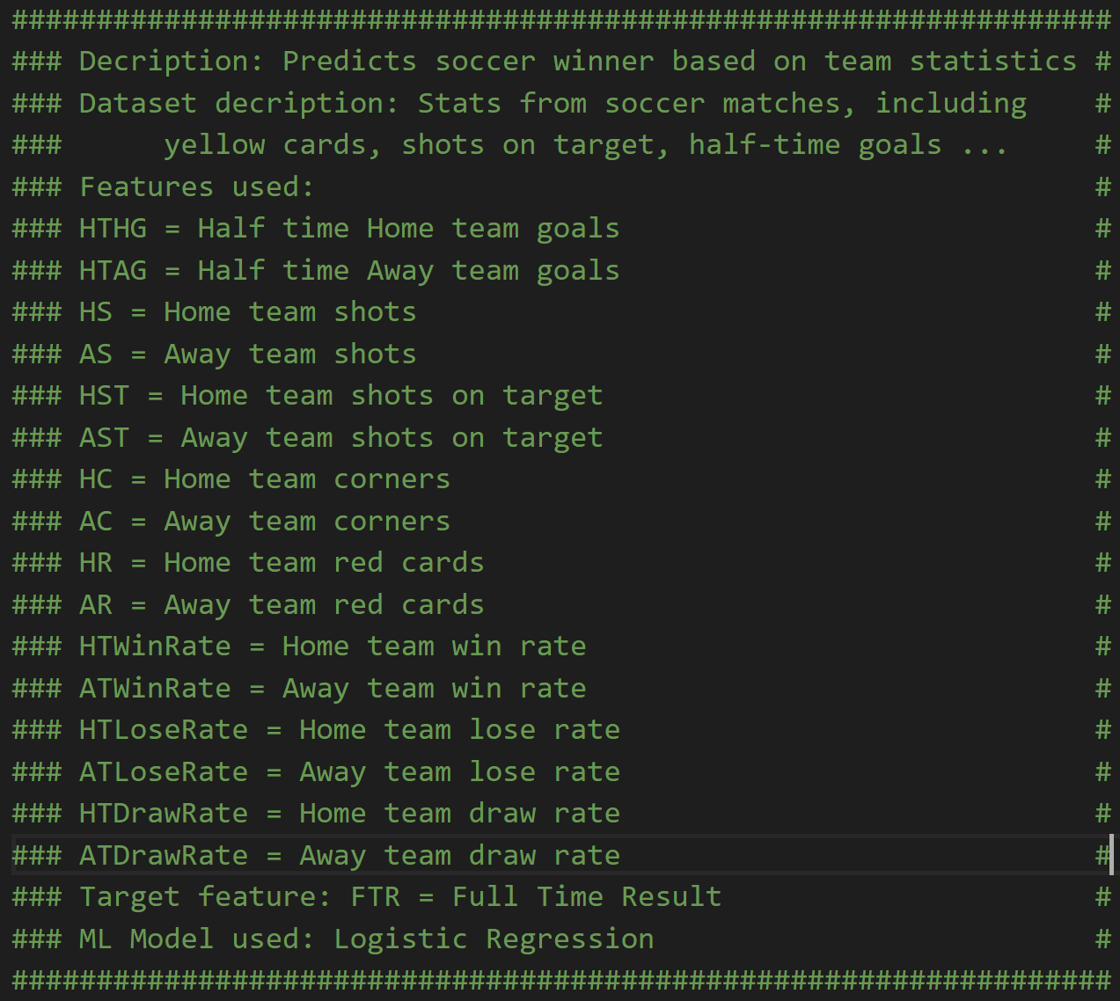
Features used for training and recognition

Slide 5
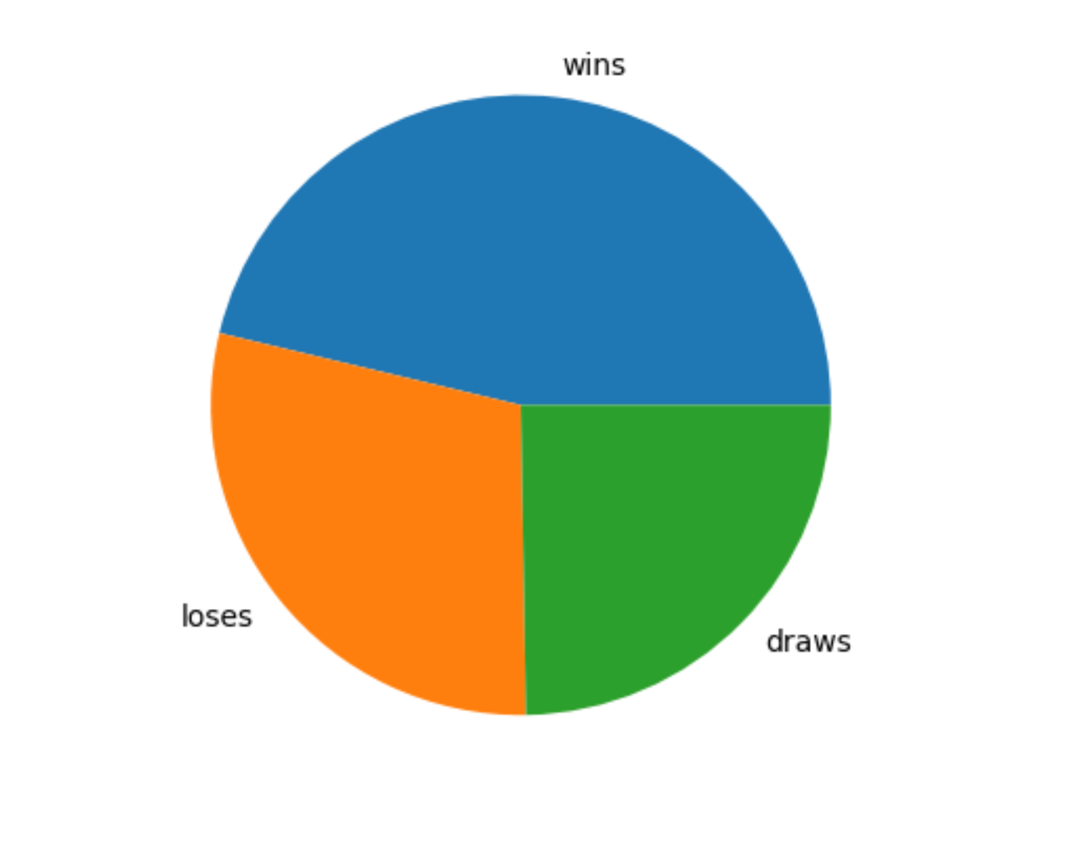
Expected winner in most of the cases: The home team
46.25%
Based on observation and calculations the home team has better chances of winning. Not only in the English Premier League but in 4 other leagues the winning team wins the matches in more than 40% of the cases.
28.99%
24.73%
Premier league, home team statistics in the past 10 seasons

Slide 6
Model choice
Logistic regression: Since the target feature is categorical: H, A, W (Home team wins, Away team wins, Draw), has statistics some features do not have linear relationship with other features, logistic regression is a good choice. The category with the highest probability (likelihood) is chosen.
Support vector machines: Support vector machines can be a better choice than using decision trees for example, because decision trees partition the space in straight lines.

Slide 7
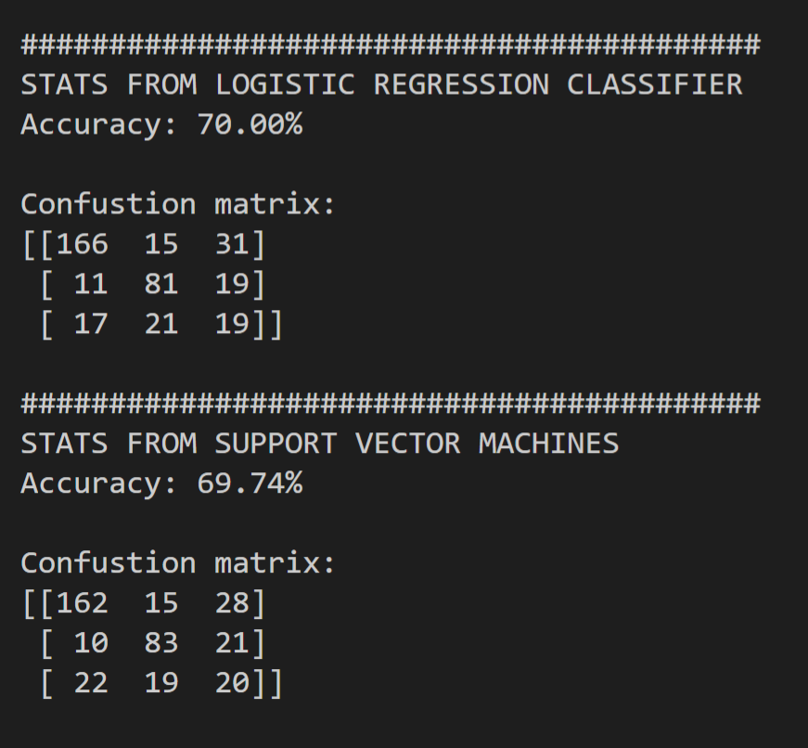

Logistic regression vs. SVM - Premier league data

Slide 8
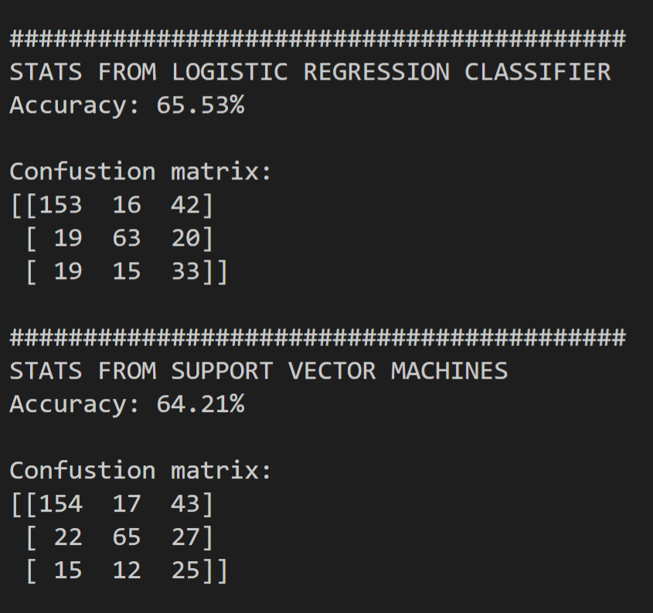

Logistic regression vs SVM – La Liga

Slide 9
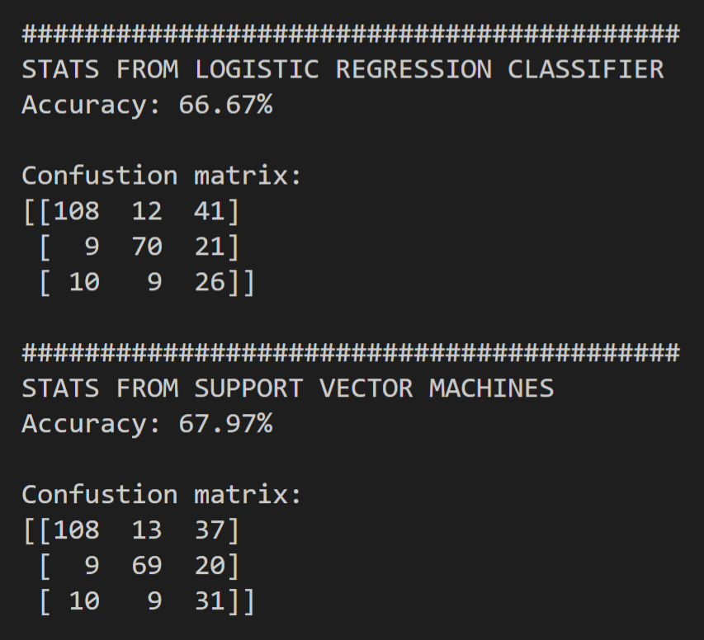

Logistic regression vs SVM - BundesLiga

Slide 10
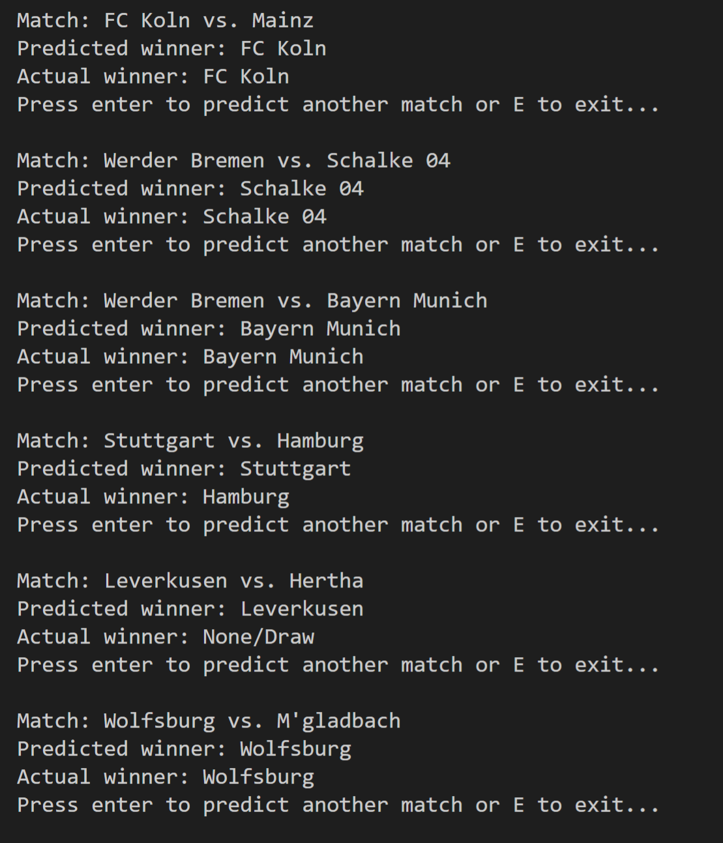
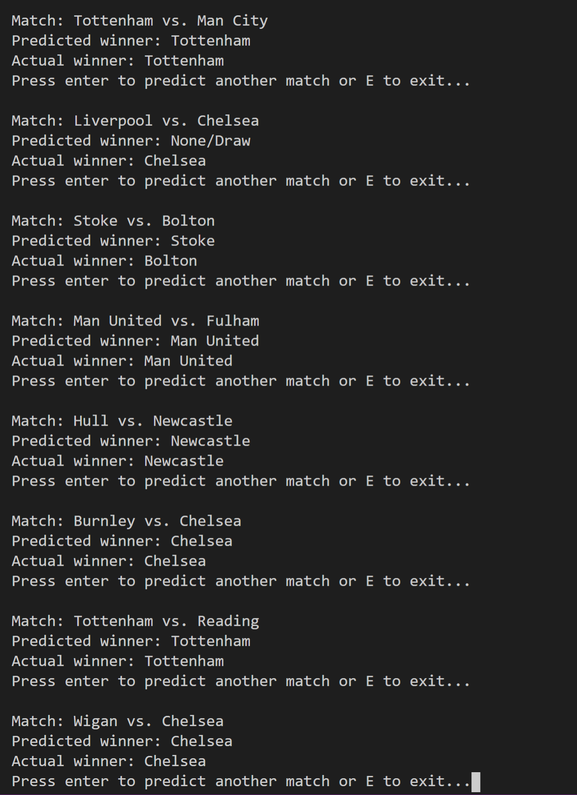
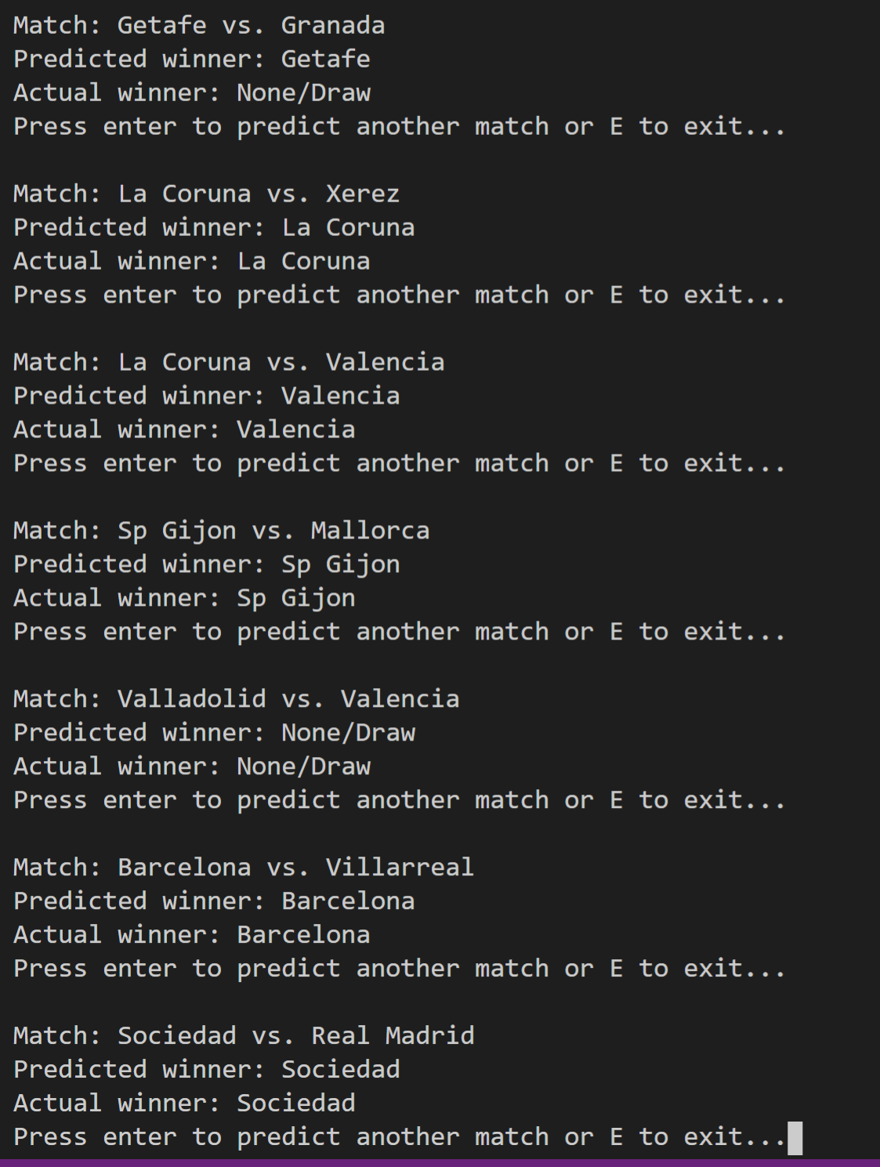
Program output

Slide 11
Conclusion
Both Logistic regression and SVM produce test accuracy of around 70%. That is not very good accuracy, but based on the unpredictability of the soccer matches, it is not bad either.
Improvements: The dataset is not great, and it is missing some key features like: Team ball possession which can tell a lot about the team dominance, team win streaks, team form, key players and so on…
With better dataset, both the Logistic Regression and SVM will produce better results with testing accuracy of at least 80%. Neural networks will do even better job, since we can use twitter data, soccer analytics, comments, and other data to predict the best possible outcome.

